Slide 1
Sorting Manipulator
Robotic Operating System and Robot Simulation
21AIE213
Done By-
BL.EN. U4AIE21126 Suryamritha M
BL.EN. U4AIE21128 TVNL Harshitha
BL.EN. U4AIE21139 Varshini Balaji

Slide 2

Problem Statement
Project 7: Sorting Manipulator
Design and implement a sorting robotic arm to sort the objects based on the color. The manipulator should be build from scratch. The input of the system can be locations of the objects and color based destination points. The system should be tested with minimum of three different colors. The type of sensors can be team’s choice but the reason to use the sensor should be clear in the report and the presentation.

Slide 3
IMPLEMENTATION :
Create a package named ‘cougerbot’ in src of ros workspace.
Create config, launch and urdf folders inside the package.
Create and edit controller, launch and urdf files in respective folders.
Urdf file is to create links and joints and properties of the links and joints.
In controllers.yaml file, we specify all the joints of the manipulator
Create nodes to spawn the bot and the other node(first_node.py) to assign the co-ordinates to the manipulator .

Slide 4
5.Create python files to give all the co-ordinates of numbers and to spawn the bot.
6.We create a launch file to launch these 2 nodes at atime. One node is gazebo empty world and the spawn_node which spawns the manipulator.
7.Now run launch file and co-ordinates node to run in gazebo. (Commands)
ros2 launch cougerbot cougerbot_launch.xml
ros2 run cougerbot cougerbot_node

Slide 5
Flow Chart
Create urdf file, which contains all the links & joints of manipulator
Create launch file, which launches gazebo along with manipulator
Create controllers file
Launch the second node file to give input of colors
Create another node which contains coordinates of the numbers
Create a node to spawn the robot

Slide 6
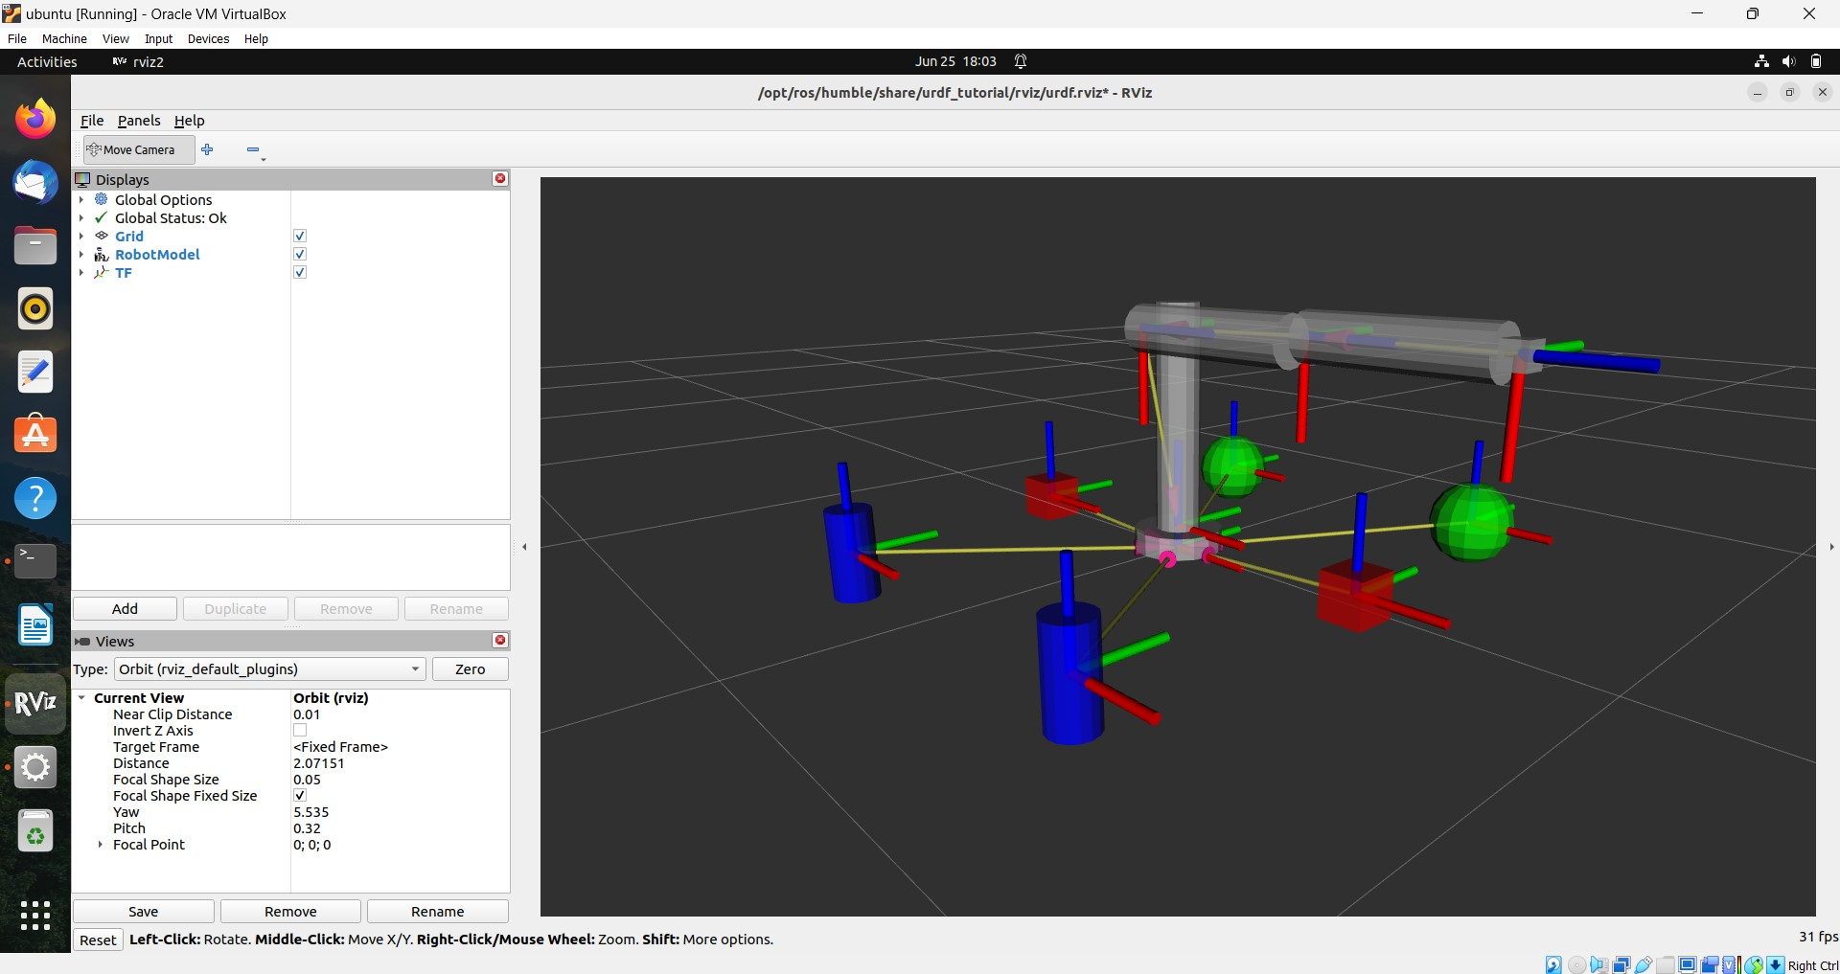
Fig 1. In RVIZ, Design Sorting Manipulator

Slide 7
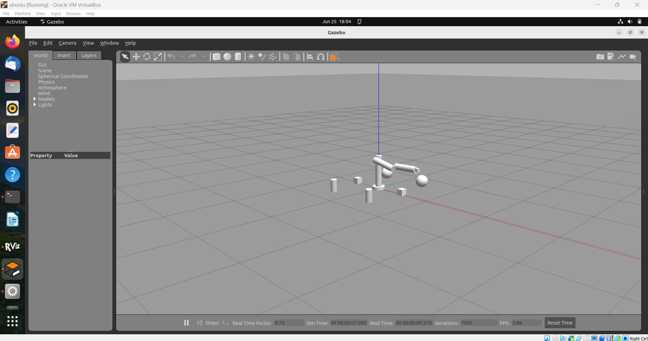
Manipulator in Initial condition

Slide 8
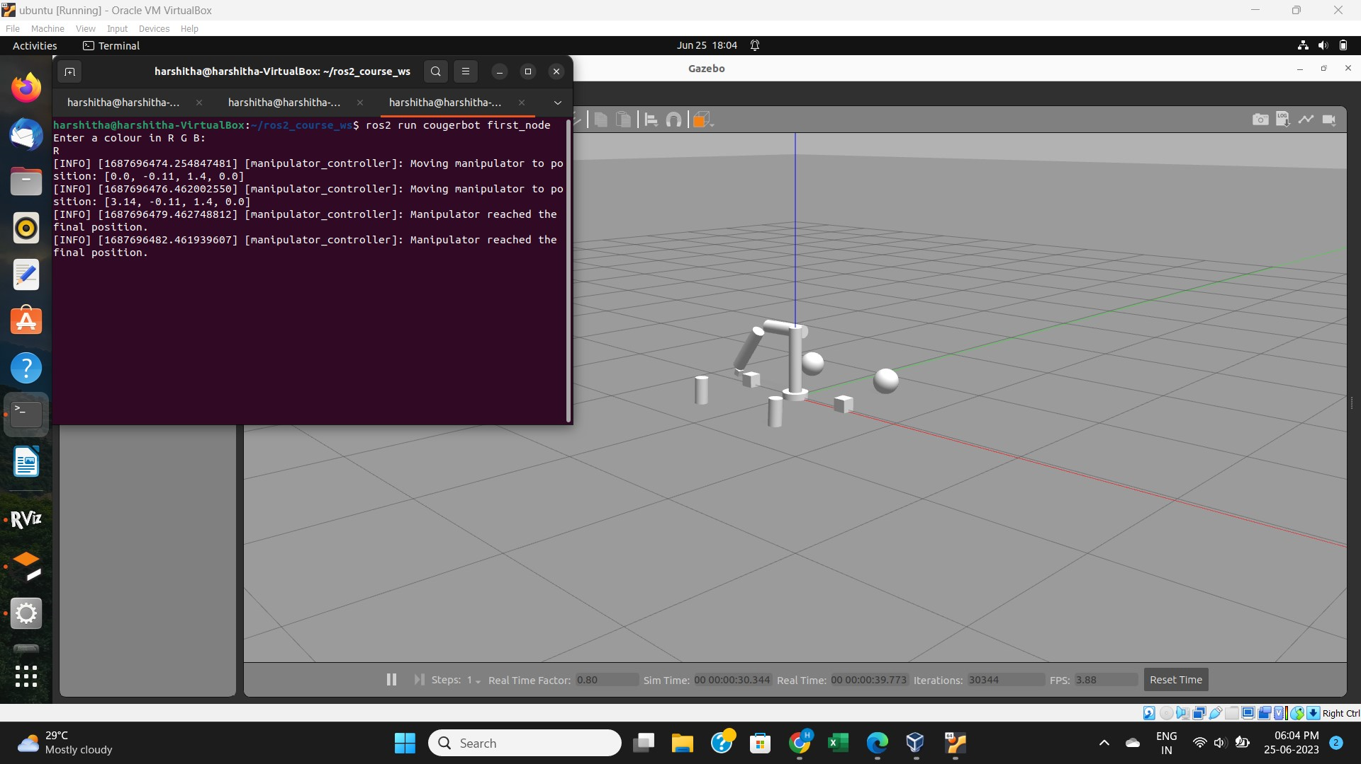
Result
Test case –I: Giving R as input

Slide 9
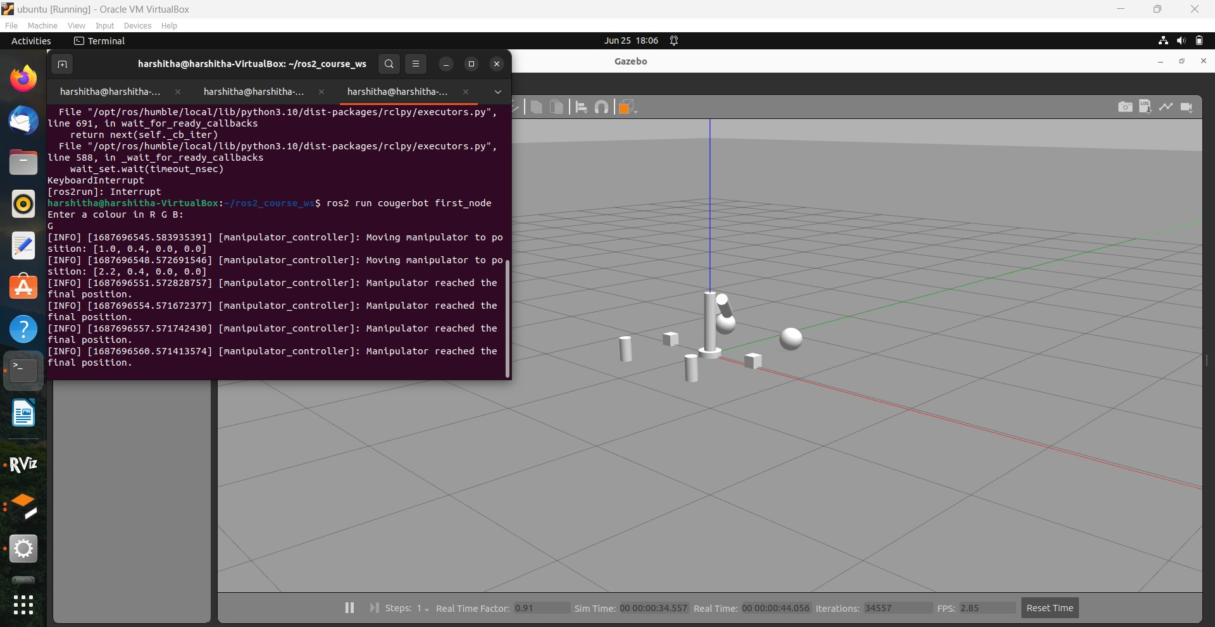
Test case –II:​ Giving G as input

Slide 10
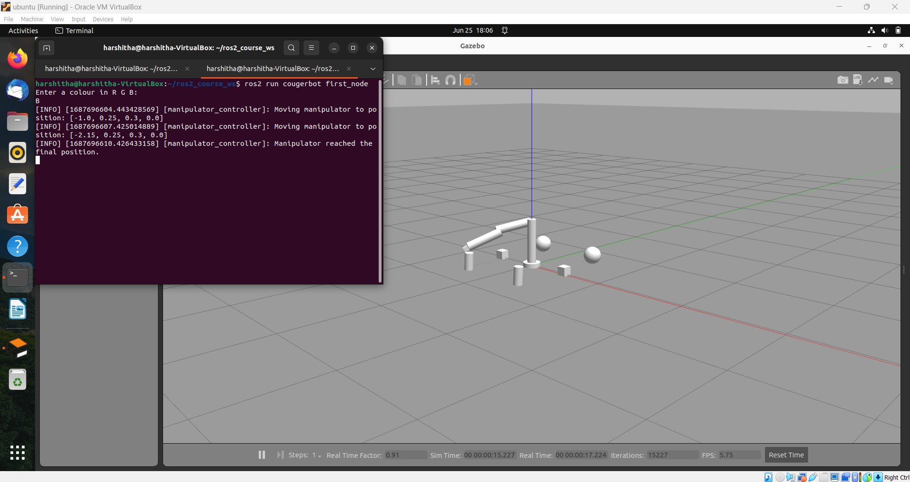
Test case –III:​ Giving B as input

Slide 11
THANK YOU

Slide 12
References

